Slide 1
NutriBuddy: AI-Driven Personalized Recommender System
DS5500: Capstone
Date: March 17, 2025
Venkat Srinivasa Raghavan,Deepak Udayakumar, Aadarsh Gaikwad

Slide 2
Objectives
What the Experiment Aims to Achieve:
Develop and refine Nutribuddy’s hybrid recommendation system for meal and exercise suggestions.
Compare different AI models (Content-Based, Collaborative, Hybrid) to determine the most effective approach.
Improve real-time ranking based on user feedback, medical history, and dietary needs.
Main Problem the ML Models Address:
Cold-Start Problem – How to recommend meals to new users with no prior data.
Evolving User Preferences – Ensure adaptive recommendations as user needs change.
Lack of Diversity – Prevent repetitive meal suggestions.
Community Influence – Use similar user behaviors to enhance meal recommendations.
Significance of the Study:
Healthcare Impact – Personalized meal plans for users with medical conditions.
AI Advancement – Improving hybrid recommendation models for personalized nutrition.
User Experience – Reducing decision fatigue with smarter meal choices.

Slide 3

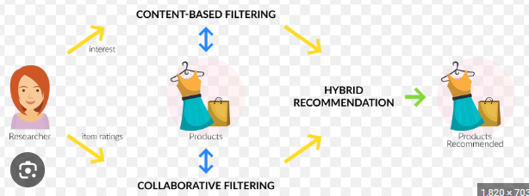
Hypothesis
Key Hypotheses to Be Tested:
H1: Hybrid models (Content-Based + Collaborative) improve personalization & diversity.
H2: Dynamic re-ranking boosts user satisfaction & meal adoption.
H3: Community-driven recommendations enhance meal relevance & retention.
H4: LLM-based medical history processing ensures accurate dietary suggestions.
Expected Outcomes:
Hybrid models → Better balance of personalization + diversity in meal suggestions.
Dynamic re-ranking → Increased click-through rates, purchases, and engagement.
Community-driven insights → Higher trust and adherence to recommendations.
Medical history processing → More accurate recommendations for users with dietary constraints.
Why These Hypotheses Matter:
NutriBuddy delivers relevant & personalized meal suggestions.
Advances AI-driven nutrition & health recommendations.
Proves hybrid models outperform traditional approaches.

Slide 4
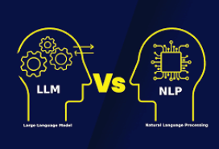
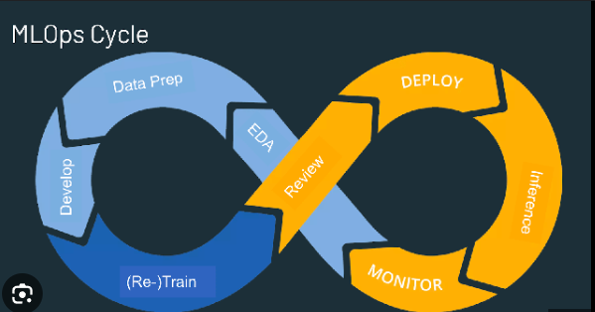
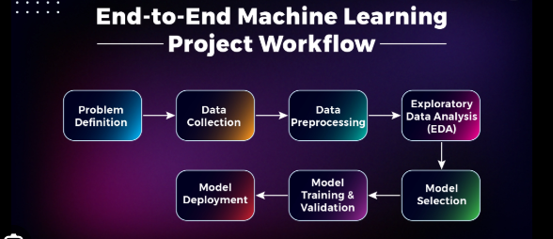
Personal learning objectives
What We Aim to Learn:
Apply ML & MLOps for a scalable AI recommendation system.
Gain experience in LLM integration, data processing, and real-time optimization.
Improve frontend-backend API communication for real-world applications.
Key Technical & Conceptual Skills:
MLOps & Deployment – Automating ML pipelines, ensuring scalability.
Hybrid Recommender Systems – Content-Based + Collaborative Filtering.
NLP & LLM Integration – Extracting structured insights from user inputs.
Career Impact:
Strengthen expertise in MLOps & cloud-based AI deployment.
Gain real-world experience in personalized recommendation systems.
Build end-to-end ML expertise from data engineering to production.

Slide 5
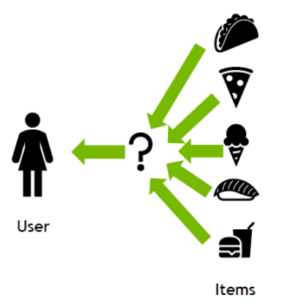
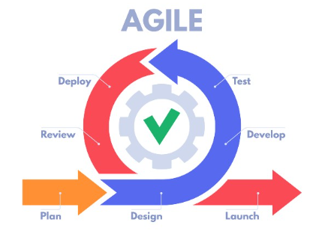
Team learning Objectives
Collective Goals:
Develop a scalable, AI-powered meal recommendation system.
Improve collaborative problem-solving & decision-making in ML & AI.
Strengthen team coordination across ML, NLP, frontend, and deployment.
Collaboration & Problem-Solving:
Work across interdisciplinary roles (ML, DevOps, NLP, UI/UX) to build a unified system.
Enhance peer learning & knowledge sharing to solve complex technical challenges.
Develop agile workflow & task delegation for efficiency.
Expected Takeaways:
Experience in building & deploying AI-driven applications as a team.
Improved technical & communication skills for future projects.
Stronger problem-solving & adaptability in real-world ML/AI systems.

Slide 6


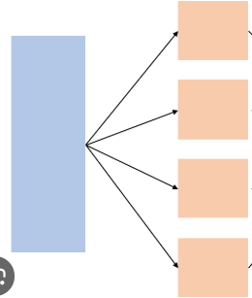
Challenges
Anticipated Difficulties:
Data Issues: Incomplete or inconsistent meal & user interaction data.
Preprocessing Complexity: Handling unstructured dietary inputs & medical history.
Model Performance: Balancing personalization, diversity, & real-time adaptation.
Computational & Resource Constraints:
Scalability: High computational cost for dynamic re-ranking & hybrid models.
LLM Integration: Processing large-scale text data efficiently.
Real-Time Processing: Ensuring low latency in meal recommendations.
Strategies to Overcome:
Data Enrichment: Use synthetic data generation & feature engineering.
Efficient Processing: Optimize preprocessing pipelines & model inference speeds.
Cloud & Parallelization: Leverage cloud-based solutions & distributed computing.

Slide 7
Timeline & Key Milestones
Jan 3rd - Mar 2nd Week → Scoping, Data Collection & Model Development
Defined objectives, system architecture, and datasets.
Processed data, built hybrid models for diet, integrated LLM.
Mar 3rd - Mar 4th Week→ Exercise Recommendation & Optimization
Develop exercise recommendation model.
Optimize performance & scalability.
Apr 1st - Apr 2nd Week → Final Testing & Deployment
Test & validate system, deploy recommendation engine & UI.
Submit final report & presentation.
Adjustments for Delays:
Data issues? → Use synthetic data & feature engineering.
Model performance challenges? → Optimize hyperparameters & infrastructure.
Unforeseen delays? → Reallocate tasks & focus on critical components first.
Final Submission
Provide a fully functional nutribuddy application.

Slide 8
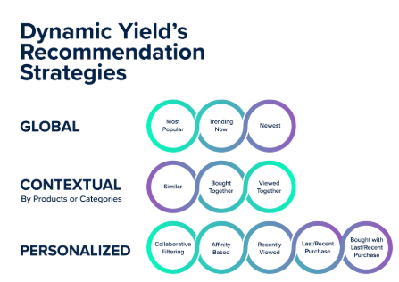
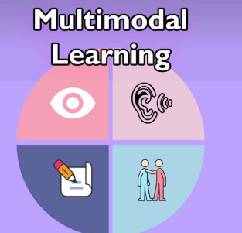
FUTURE DIRECTION
Expansion & Improvements:
Enhancing personalization by incorporating more user behavioral data.
Integrating real-time feedback loops for adaptive meal recommendations.
Scaling exercise recommendations with personalized fitness plans.
Potential Applications:
Healthcare & Nutrition – Tailored meal plans for dietary and medical needs.
E-commerce & Meal Delivery – AI-driven personalized meal suggestions.
Wearable & Health Apps – Integration with fitness trackers for dynamic diet plans.
Further Research Opportunities:
Reinforcement Learning to continuously improve recommendations.
Multi-modal AI (combining text, images, and user interactions).
Cross-domain recommendations (meal + exercise + lifestyle).

Slide 9
Team members contribution: Venkat Srinivasa Raghavan
Role: Machine Learning & Data Processing
Key Contributions:
Preprocessed & cleaned large datasets using Pandas & NumPy.
Developed & fine-tuned ML models (Collaborative & Content-Based Filtering).
Designed & implemented efficient API communication for real-time data retrieval.
Integrated NLP outputs from LLM for personalized recommendations.
Impact on Project:
Ensured high-quality data for accurate meal recommendations.
Improved system efficiency & scalability for real-time performance.

Slide 10
Team members contribution: Deepak udayakumar
Role: LLM Integration & NLP Processing
Key Contributions:
Developed prompt engineering strategies for extracting insights from blood reports & user preferences.
Integrated LLMs into the recommendation system for context-aware meal suggestions.
Preprocessed textual data using NLP libraries (spaCy, NLTK) for better input handling.
Optimized model deployment & API communication for real-time processing.
Impact on Project:
Enhanced AI-driven personalization through accurate dietary recommendations.
Improved system efficiency & real-time interaction with LLM-powered meal suggestions.

Slide 11
Team members contribution: Aadarsh Gaikwad
Role: Frontend Development & UI/UX
Key Contributions:
Developed a dynamic & responsive UI using React for seamless user experience.
Created intuitive visualizations & workflows to display personalized diet & exercise recommendations.
Optimized model performance & scalability using Docker.
Impact on Project:
Ensured smooth user interaction with AI-driven recommendations.
Improved data accessibility & visualization for better decision-making.

